Slide 1
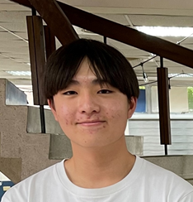
Facilitators and Barriers to Online Treatment Usage for Taiwanese People With and Without Experience
Ju-Chun Chien¹, Samantha Shih², Edward Wu², Louis Tsai²
¹Department of Healthcare Administration, Asia Eastern University of Science and Technology
² Morrison Academy Taichung
ISQua’s 39th International Conference
Seoul, Republic of Korea
Tuesday, 29 August 2023, at 10:45
15-minute Oral Presentation

Slide 2
Introduction
Online Treatment, also referred to as telemedicine, was a health-related service by means of information and communication technology (ICT) in order to provide timely medical diagnosis, treatment and monitoring of patients at any location.
The major advantages of online treatment were:
To deliver treatments for isolated populations (Parmar et al., 2015)
More convenient (Dorsey et al., 2020)
Cheaper (Lakshin et al., 2021; Wootton, 2001)
To spare the time (Caponnetto et al., 2022)
To prevent infection (Kapoor et al., 2020)

Slide 3
Some disadvantages of online treatment were:
Inability to perform full physical examination (Stifani et al., 2021)
To increase potential diagnostic errors (Wang et al., 2023)
The digital divide (Kichloo et al., 2020)
People with poor technological literacy (Florea et al., 2021)
Increased security concerns (Mills et al., 2020)
Despite the above limitations, in general, patients consistently reported a high level of satisfaction with telemedicine-based care (Alsabeeha et al., 2023; Lakshin et al., 2021; Nie et al., 2022; Parmar et al., 2015; Pogorzelska & Chlabicz, 2022; Yoon et al., 2021). In addition, online treatment usage increased rapidly during the COVID-19 pandemic (Nittari et al., 2022).

Slide 4
In 2020, the Institute for Healthcare Improvement developed a framework for ensuring safe, equitable, person-centered telemedicine (Perry et al., 2021). The six elements were:
Access: Overcome infrastructure and technological barriers
Privacy: Manage cybersecurity risk
Diagnostic Accuracy: Reduce diagnostic errors
Communication: Offer training to providers and patients to diminish technical, emotional, and psychological communication challenges
Psychological and Emotional Safety: Be mutually reinforcing between patients and providers
Human Factors and System Design: Be fully integrated into the existing system and apply user-centered co-design

Slide 5
In other words, to successful implementation of online treatment, patients’ psychological concerns, IT skills, and related trainings were addressed.
Moreover, one of the factors that influenced online treatment adoption was digital literacy (Lopez et al., 2021). In addition, anxiety to technology was related to willingness to use telepsychiatry (Werner, 2004).
On the other hand, the Theory of Planned Behavior Model could explain 85.8% of the intention to use telemedicine (Ramírez-Correa et al., 2020).

Slide 6
Taiwan’s National Health Insurance (NHI) System has implemented for 20 years. It has provided most convenient healthcare possible. However, according to National Health Insurance Administration (NHIA), even during the COVID-19 pandemic, about 33,000 Taiwanese people still sought medical treatment (doctor shopping) more than 90 times per person in 2020.
On the other hand, there was still room for improvement in Taiwanese people’s awareness and needs for telemedicine in 2020 (Chang et al., 2021).
Facing the COVID-19 outbreak and related lockdown, from May 2021, NHIA expanded telemedicine services to all citizens. Therefore, more and more people started experiencing online treatment in Taiwan.

Slide 7
This study was conducted in 2022. In addition to exploring the reasons and concerns about online treatment usage between Taiwanese people with and without the experience, by means of the extended Theory of Planned Behavior (TPB) model, the present study also examining principal predictors of online treatment behavioral intention.

Slide 8
Personal Background
Sex/Age/Education Marriage/Job/Living Alone Visit Doctors Independently Return Visits Regularly Surgical Treatment Exp. Medical APPs Usage Know of Online Treatment Online Treatment Exp. OT Third Party Assistance OT Effective Comparison OT Facilitating/Hindering
Attitude
Intention to Perform Online Treatment
Subjective Norm
PBC: IT Skills
OT Training Needs
OT Anxiety
Figure 1: Framework for the Main Study

Slide 9
Objectives
Understand the proportion of observations in the sample that have actual experience of online treatment and to reveal participants’ perceived benefits and barriers about the use of online treatment.
Examine the differential effects of personal background information on online treatment behavioral intention.
Analyze the differences between experienced and inexperienced OT individuals in the background variables and the main dependent variables.
Investigate the correlation between the main continuous variables to OT behavioral intention.
Identify the important predictors of OT behavioral intention.

Slide 10
Methods: Participants
A pilot study with 426 valid participants was conducted to test the quality and efficiency of the self-developed online questionnaire through the 7-point Likert scale.
The main study was surveyed online from October 26 to November 26 in 2022. The data were gathered using convenience sampling, with a total of 1506 valid participants (88.10%) remaining after conducting the reverse wording attention check method.

Slide 11
Methods: Instrument
The final research instrument contained 9 parts: Personal background information (14 items), OT benefits (6 statements), and OT barriers (8 statements). Moreover, behavioral intention (BI, 6 items), Attitude (ATT, 7 items), Subjective Norm (SN, 6 items), PBC: IT skills (ITS, 5 items), Training Needs (TN, 5 items), and OT Anxiety (ANX, 5 items)
After conducting the attention check, the EFA, and the internal consistency tests, the final self-developed online questionnaire on a seven-point Likert scale had good construct validity (total variance explained from 57.28% to 73.13%) and reliability (Cronbach’s alpha from .87 to .91).

Slide 12
Table1: Summary of the validity and reliability of the self-developed questionnaires
Variable (n = 1506) | # | # of Items to Delete | M _{Item} | SD _{Item} | α | Total Variance Explained | KMO | PAF Communalities | Factor Loadings
Attitude | 7 | 0 | 5.66 | .97 | .87 | 57.28% | .89 | .35 ~ .65 | .61 ~ .86
Subjective Norm | 6 | 0 | 4.94 | 1.11 | .91 | 68.44% | .83 | .52 ~ .83 | .68 ~ .83
IT Skills | 5 | 1 | 5.67 | 1.13 | .91 | 73.13% | .87 | .47 ~ .75 | .70 ~ .93
OT Training Needs | 5 | 0 | 4.22 | 1.31 | .91 | 72.97% | .85 | .39 ~ .80 | .64 ~ .92
OT Anxiety | 5 | 2 | 3.36 | 1.22 | .85 | 62.86% | .77 | .39 ~ .68 | .61 ~ .81
Behavioral Intention | 6 | 0 | 5.16 | 1.15 | .90 | 67.46% | .86 | .49 ~ .68 | .74 ~ .82

Slide 13
Definition Of Terms
Attitude Toward the Behavior (ATT) Online treatment is positively or negatively valued by the person. The higher the average score, the more positive an individual’s attitude toward online treatment.
Subjective Norm (SN) The degree to which a person perceived significant others believed they should use or not to use online treatment. The higher the mean score meant the more social support the person perceived.
Perceived Behavioral Control: IT Skills (PBC: ITS) The degree to which a person’s perception of his or her IT ability to perform online treatment. The higher the mean score, the more the person believed that his or her IT skills were sufficient to perform online treatment.

Slide 14
Online Treatment Training Needs (OT_TN) A person’s willingness to enhance knowledge and skills in online treatment through training. The higher the mean score, the more the person considered the necessity of acquiring further knowledge on online treatment.
Online Treatment Anxiety (OT_ANX) The degree to which a person’s perception of his or her anxiety in front of online treatment. The higher the mean score, the more the person felt uncomfortable and worry about online treatment usage.
Online Treatment Behavioral Intention (OT_BI) A person’s readiness to engage in online treatment. The higher the mean score, the stronger the online treatment usage intention.

Slide 15
Attitude Toward the Behavior
ATT01 | 我認為「視訊診療」能節省舟車往返的時間。 I think telemedicine can effectively save travel time.
ATT02 | 我認為「視訊診療」能降低外出感染病毒的風險。 I believe telemedicine can reduce the risk of contracting the virus when going out.
ATT03 | 我認為「視訊診療」能服務無法外出就醫的病人。 I think telemedicine can serve those who cannot go out for medical treatment.
ATT04 | 我認為「視訊診療」有利於病情的追蹤。 I think telemedicine can be helpful for disease tracking.
ATT05 | 疫情期間採用「視訊診療」能滿足我的就醫需求。 Telemedicine meets my medical needs during the pandemic.
ATT06 | 我認為「視訊診療」是高便利性的醫療服務。 I believe telemedicine is a high-convenience medical service.
ATT07 | 我認為在台灣發展「視訊診療」有其必要性。 I think it is necessary to develop telemedicine in Taiwan.

Slide 16
Subjective Norm
SN01 | 我的家人支持我以「視訊診療」的方式就醫。 My family supports me to use telemedicine.
SN02 | 我所重視的人贊成我以「視訊診療」的方式就醫。 Significant others approve of my use of telemedicine.
SN03 | 我的醫師會認為我適合使用「視訊診療」。 My doctor thinks I am suitable for telemedicine.
SN04 | 醫療院所鼓勵患者使用「視訊診療」。 Medical institutions encourage patients to use telemedicine.
SN05 | 大眾傳播媒體大力宣傳「視訊診療」的服務。 The mass media actively promote the service of telemedicine.
SN06 | 政府積極制定「視訊診療」的相關配套措施。 The government actively develop various supporting policy for telemedicine.

Slide 17
PBC: IT Skills
ITS01 | 遇到疑難雜症我習慣先上網查資料找解方。 Whenever there is a problem, I will firstly search for solutions on the Internet.
ITS02 | 我能熟練使用線上視訊軟體。 I can use online video software proficiently.
ITS03 | 我能進行資訊設備簡易故障排除。 I can perform simple troubleshooting of information equipment.
ITS04 | 我能獨立完成就醫時的網路預約掛號程序。 I can successfully schedule a medical appointment online alone.
ITS05 | 家中的硬體設備能符合「視訊診療」的規格要求。 The hardware equipment in my house meets the requirements of telemedicine.
ITS06 | 我認為自己能順暢操作遠距視訊診療系統。 I believe that I can operate the telemedicine system smoothly.
.

Slide 18
OT Training Needs
TN01 | 我想要參加「視訊診療系統」的操作使用課程 I want to take part in the telemedicine system operation program.
TN02 | 我想要學習以APP記錄個人基本生命徵象數據 I am willing to learn to record personal basic vital signs with apps.
TN03 | 我想要參加增進視訊醫病溝通品質的課程 I want to take a course to improve the quality of telemedicine communication.
TN04 | 我想要參加視訊診療病患權益須知的課程 I want to attend a course on the rights of patients in telemedicine.
TN05 | 我想要參加檢驗報告數據/圖表的解讀課程 I want to take a course on interpreting inspection report data/graphs.
.

Slide 19
OT Anxiety
ANX01 | 面對「視訊診療」，我擔心聽不懂醫師的提問。 In front of telemedicine, I am worried that I can’t fully understand the doctor’s questions.
ANX02 | 面對「視訊診療」，我較難清楚描述自己的病症。 In front of telemedicine, I have difficulty in describing my symptoms clearly.
ANX03 | 面對「視訊診療」，我的專注力會明顯下降。 In front of telemedicine, my concentration will drop significantly.
ANX04 | 面對「視訊診療」，我會有被人盯著看的壓迫感。 In front of telemedicine, it makes me feel oppressed.
ANX05 | 面對「視訊診療」，我就是感到渾身不自在。 I feel uncomfortable in front of telemedicine.
ANX06 | 面對「視訊診療」，我在意自己的外表形象。 In front of telemedicine, I care about my appearance.
ANX07 | 面對「視訊診療」，我介意會被全程錄影。 In front of telemedicine, I mind being Videotaped the whole time.
.

Slide 20
Behavioral Intention
BI01 | 我願意嘗試採用「視訊診療」的服務。 I am willing to use telemedicine.
BI02 | 我已經準備好隨時可以使用「視訊診療」的服務。 I am ready and able to use telemedicine at any time.
BI03 | 我願意更新設備以提升「距視訊診療」的品質。 I am willing to update my equipment to improve the quality of telemedicine.
BI04 | 我願意關注「視訊診療」的相關報導。 I am willing to pay attention to news on telemedicine.
BI05 | 我願意了解「遠距視訊診療」的法令規章。 I would like to know the laws and regulations of telemedicine.
BI06 | 我會推薦他人使用「視訊診療」的服務。 I would recommend telemedicine to others.

Slide 21
Methods: Statistical Analysis
Descriptive statistics, exploratory factor analysis (EFA), reliability analysis, contingency table analysis, ANOVA, correlation analysis, and multiple stepwise regression were utilized for data analysis.

Slide 22
Results
Ninety percent of the participants (n = 1356) knew of online treatment service; moreover, they displayed a positive intention to use online treatment (5.16 ± 1.15). The majority of people could find someone to handle online treatment issues (n = 1239, 82.3%), and about 55% of the participants had online treatment experience (n = 825). About half of participants (n = 752, 49.9%) considered online treatment was as effective as or better than in-person treatment.
The three most facilitators for online treatment usage were: (1) Be unable to attend all doctor visits (n = 636, 42.2%), (2) Follow the anti-coronavirus measures (n = 415, 27.6%), and (3) Prevent infections (n = 217, 14.4%).

Slide 23
The three most concerns for online treatment usage were: (1) Increase the risk of diagnostic errors (n = 808, 53.7%), (2) Be difficult to discuss conditions on camera (n = 195, 12.9%), and (3) Have poor picture or sound quality (n = 176, 11.7%).
Participants who were female, had higher education, had full-time job, were married, and could visit doctors independently showed significantly higher intention to engage in online treatment, respectively. In addition, participants who knew of online treatment service, had OT experience, used medical APPs, could find someone to handle OT issues, had positive OT service evaluation reported significantly higher levels of intention to adopt OT, respectively.

Slide 24
Compared to people without online treatment experience, those with OT experience revealed significant higher scores in Behavioral Intention, Attitude, Subjective Norm, PBC: IT Skills, respectively. In addition, people without OT experience reported a significant higher score on OT Training Needs and OT Anxiety, respectively.
Compared to people without online treatment experience, there was a significant amount of people with OT experience chose “Follow the anti-coronavirus measures” as their main reason. On the other hand, a greater proportion of people without OT experience chose “Prevent infections,” “Request by the physician,” and “Provide plenty of usage incentives” as their main reason to use OT.

Slide 25
Compared to people without online treatment experience, there was a significant amount of people with OT experience chose “Have poor picture or sound quality” and “Have an unstable Power/Internet connection” as their main concern. On the other hand, a greater proportion of people without OT experience chose “Increase the risk of diagnostic errors,” “Don’t know how to perform the software system,” and “Lack the hardware equipment at home” as their main concern to use OT.

Slide 26
Results
OT Exp.
Female
Know of OT
Without OT Exp.
Married
OT Assistance
Full-time Job
Medical APPs Usage
Living with SB.
Junior High and Under/ University
Positive Evaluation of OT
Personal Background Information

Slide 27
There was a moderate correlation (from .40** to .64**) between Attitude, Subjective Norm, PBC: IT Skills, OT Training Needs, OT Anxiety, and OT Behavioral Intention, respectively. More specifically, OT Anxiety was negatively correlated (–.40**) with OT Behavioral Intention.
The best predictors to influence online treatment intention were Subjective Norm (β = .32), OT Training Needs (β =.32), PBC: IT Skills (β =.21), Attitude (β =.17), OT Anxiety (β = –.13), OT Experience (β =.07), and Female (β =.04). These predictors accounted for 63% of the total variance. The regression equation～
BI = .28 + .33X₁ +.28X₂ +.21X₃ +.20X₄ – .12X₅ + .16X₆ +.10X₇

Slide 28
Table 2: Descriptive statistics for the categorical variables
 |  |  |  | Online Treatment Experience
 |  |  |  | YES |  | NO
 |  | Total | % | N | % | N | %
Variable | Level | 1506 | 100 | 825 | 54.8 | 681 | 45.2
Sex | Male | 681 | 45.2 | 318 | 38.5 | 363 | 53.3
 | Female | 825 | 54.8 | 507 | 61.5 | 318 | 46.7
Education | Junior High | 51 | 3.4 | 36 | 4.4 | 15 | 2.2
 | High School | 461 | 30.6 | 208 | 25.2 | 253 | 37.2
 | University | 739 | 49.1 | 451 | 54.7 | 288 | 42.3
 | Graduate | 255 | 16.9 | 130 | 15.8 | 125 | 18.4
Employment | Unemployed | 487 | 32.3 | 232 | 28.1 | 255 | 37.4
 | Part-time | 95 | 6.3 | 53 | 6.4 | 42 | 6.2
 | Full-time | 881 | 58.5 | 517 | 62.7 | 364 | 53.5
 | Full & Part | 43 | 2.9 | 23 | 2.8 | 20 | 2.9

Slide 29
 |  |  |  | Online Treatment Experience
 |  |  |  | YES |  | NO
 |  | Total | % | N | % | N | %
Variable | Level | 1506 | 100 | 825 | 54.8 | 681 | 45.2
Marital Status | Unmarried | 550 | 36.5 | 264 | 32.0 | 286 | 42.0
 | Married | 887 | 58.9 | 519 | 62.9 | 368 | 54.0
 | Divorced | 48 | 3.2 | 27 | 3.3 | 21 | 3.1
 | Widowed | 21 | 1.4 | 15 | 1.8 | 6 | 0.9
Living Along | Yes | 129 | 8.6 | 54 | 6.5 | 75 | 11.0
 | No | 1377 | 91.4 | 771 | 93.5 | 606 | 89.0
Visit Doctors | Yes | 1400 | 93.0 | 773 | 93.7 | 627 | 92.1
Independently | No | 106 | 7.0 | 52 | 6.3 | 54 | 7.9
Regular doctor visits | Yes | 415 | 27.6 | 230 | 27.9 | 185 | 27.2
 | No | 1091 | 72.4 | 595 | 72.1 | 496 | 72.8
Surgical Experience | Yes | 531 | 35.3 | 295 | 35.8 | 236 | 34.7
 | No | 975 | 64.7 | 530 | 64.2 | 445 | 65.3

Slide 30
 |  |  |  | Online Treatment Experience
 |  |  |  | YES |  | NO
 |  | Total | % | N | % | N | %
Variable | Level | 1506 | 100 | 825 | 54.8 | 681 | 45.2
Medical APPs Usage | Yes | 402 | 26.7 | 255 | 30.9 | 147 | 21.6
 | No | 1104 | 73.3 | 570 | 69.1 | 534 | 78.4
Know of OT Service | Yes | 1356 | 90.0 | 825 | 100.0 | 531 | 78.0
 | No | 150 | 10.0 | 0 | 0.0 | 150 | 22.0
OT Experience | Yes | 825 | 54.8 | 825 | 100.0 | 0 | 0.0
 | No | 681 | 45.2 | 0 | 0.0 | 681 | 100.0
Can Find Someone to | Yes | 1239 | 82.3 | 765 | 92.7 | 474 | 69.6
Handle OT Issues | No | 267 | 17.7 | 60 | 7.3 | 207 | 30.4
OT Service Evaluation | Worse | 347 | 23.0 | 172 | 20.8 | 175 | 25.7
(compared to in-person treatment) | Not Sure | 407 | 27.0 | 128 | 15.5 | 279 | 41.0
 | Same | 613 | 40.7 | 432 | 52.4 | 181 | 26.6
 | Better | 139 | 9.2 | 93 | 11.3 | 46 | 6.8

Slide 31
Table 3: Descriptive statistics for the continuous variables
 |  |  |  | Online Treatment Experience
 |  |  |  | YES |  | NO
 | Minimum to Maximum | Total | % | N | % | N | %
 |  | 1506 | 100 | 825 | 54.8 | 681 | 45.2
Variable |  | M | SD | M | SD | M | SD
Age | 11 ～ 89 | 38.89 | 14.97 | 38.44 | 13.67 | 39.43 | 16.39
Intention | 1～ 7 | 5.16 | 1.15 | 5.40 | 1.09 | 4.87 | 1.14
Attitude | 1～ 7 | 5.66 | 0.97 | 5.82 | 0.92 | 5.47 | 0.99
Subjective Norm | 1～ 7 | 4.94 | 1.11 | 5.18 | 1.10 | 4.64 | 1.04
PBC: IT Skills | 1～ 7 | 5.67 | 1.13 | 5.91 | 1.05 | 5.38 | 1.16
OT Training Needs | 1～ 7 | 4.22 | 1.31 | 4.13 | 1.34 | 4.34 | 1.26
OT Anxiety | 1～ 7 | 3.36 | 1.22 | 3.16 | 1.25 | 3.59 | 1.15

Slide 32
Table 4: Descriptive statistics for OT facilitating factor
 |  |  |  | Online Treatment Experience
The best reason to use online treatment |  |  |  | YES |  | NO
 |  | Total | % | N | % | N | %
 |  | 1506 | 100 | 825 | 54.8 | 681 | 45.2
 |  | N | % | N | % | N | %
1 | Be unable to attend all doctor visits | 636 | 42.2 | 358 | 43.4 | 278 | 40.8
2 | Follow the anti-coronavirus measures | 415 | 27.6 | 268 | 32.5 | 147 | 21.6
3 | Prevent infections | 217 | 14.4 | 89 | 10.8 | 128 | 18.8
4 | Save time spent on medical treatment | 200 | 13.3 | 103 | 12.5 | 97 | 14.2
5 | Request by the physician | 19 | 1.3 | 4 | .5 | 15 | 2.2
6 | Provide plenty of usage incentives | 19 | 1.3 | 3 | .4 | 16 | 2.3

Slide 33
Table 5: Descriptive statistics for OT hindering factor
 |  |  |  | Online Treatment Experience
The most concern about using OT |  |  |  | YES |  | NO
 |  | Total | % | N | % | N | %
 |  | 1506 | 100 | 825 | 54.8 | 681 | 45.2
 |  | N | % | N | % | N | %
1 | Increase the risk of diagnostic errors | 808 | 53.7 | 405 | 49.1 | 403 | 59.2
2 | Be difficult to discuss conditions on camera | 195 | 12.9 | 112 | 13.6 | 83 | 12.2
3 | Have poor picture or sound quality | 176 | 11.7 | 117 | 14.2 | 59 | 8.7
4 | Have an unstable Power/Internet connection | 138 | 9.2 | 99 | 12 | 39 | 5.7
5 | Be unable to solve equipment problems | 66 | 4.4 | 38 | 4.6 | 28 | 4.1
6 | Be afraid of personal information leak | 64 | 4.2 | 37 | 4.5 | 27 | 4
7 | Don’t know how to perform the software system | 41 | 2.7 | 14 | 1.7 | 27 | 4
8 | Lack the hardware equipment at home | 18 | 1.2 | 3 | 0.4 | 15 | 2.2

Slide 34
Table 6: ANOVA tests for the effects of independent variables on dependent variables
Variable | Level | Mean | SD | N | F | P.E.S. | M.C.
Medical APPs Usage | YES (1) | 5.48 | 1.14 | 402 | 44.91** | .03 | (1) > (2)
 | NO (2) | 5.04 | 1.13 | 1104
Knew of OT | YES (1) | 5.22 | 1.12 | 1356 | 43.93** | .03 | (1) > (2)
 | NO (2) | 4.58 | 1.22 | 150
OT EXP. | YES (1) | 5.40 | 1.09 | 825 | 84.40** | .05 | (1) > (2)
 | NO (2) | 4.87 | 1.14 | 681
Evaluation | Worse Than (1) | 4.77 | 1.20 | 347 | 44.68** | .08 | (4) > (3) > (2), (1)
 | Not Sure (2) | 4.92 | 1.09 | 407
 | The Same (3) | 5.40 | 1.04 | 613
 | Better Than (4) | 5.76 | 1.11 | 139
Find SB. to handle OT | YES (1) | 5.27 | 1.12 | 1239 | 63.88** | .04 | (1) > (2)
 | NO (2) | 4.66 | 1.13 | 267
Dependent Variable: Behavioral intention to engage in online treatment

Slide 35
Variable | Level | Mean | SD | N | F | P.E.S. | M.C.
Sex | Male (1) | 4.99 | 1.16 | 681 | 28.42** | .02 | (2) > (1)
 | Female (2) | 5.30 | 1.11 | 825
Education | Junior High (1) | 4.79 | 1.21 | 51 | 15.46** | .03 | (3), (4) > (1), (2)
 | High School (2) | 4.89 | 1.09 | 461
 | University (3) | 5.29 | 1.15 | 739
 | Graduate (4) | 5.33 | 1.12 | 255
Employment | Unemployed (1) | 4.88 | 1.13 | 487 | 15.39** | .03 | (3) > (1)
 | Part-time (2) | 5.08 | 1.09 | 95
 | Full-time (3) | 5.32 | 1.14 | 881
 | Full & Part (4) | 5.17 | 1.07 | 43
Marital Status | Unmarried (1) | 4.92 | 1.13 | 550 | 14.89** | .03 | (2) > (1)
 | Married (2) | 5.32 | 1.12 | 887
 | Divorced (3) | 4.99 | 1.10 | 48
 | Widowed (4) | 5.04 | 1.47 | 21
Visit Doctors Independently | YES (1) | 5.20 | 1.12 | 1400 | 33.53** | .02 | (1) > (2)
 | NO (2) | 4.54 | 1.28 | 106
Dependent Variable: Behavioral intention to engage in online treatment

Slide 36
Table 7: ANOVA Summary comparison of people with or without OT experience on dependent variables
DV | IV | Mean | SD | N | F | P.E.S. | M.C.
Attitude | OT EXP. (1) | 5.82 | 0.92 | 825 | 49.27** | .03 | (1) > (2)
 | OT INEXP. (2) | 5.47 | 0.99 | 681
Subjective Norm | OT EXP. (1) | 5.18 | 1.10 | 825 | 94.59** | .06 | (1) > (2)
 | OT INEXP. (2) | 4.64 | 1.04 | 681
PBC: IT Skills | OT EXP. (1) | 5.91 | 1.05 | 825 | 88.32** | .06 | (1) > (2)
 | OT INEXP. (2) | 5.38 | 1.16 | 681
OT Training Needs | OT EXP. (1) | 4.13 | 1.34 | 825 | 9.88** | .01 | (2) > (1)
 | OT INEXP. (2) | 4.34 | 1.26 | 681
OT Anxiety | OT EXP. (1) | 3.16 | 1.25 | 825 | 47.82** | .03 | (2) > (1)
 | OT INEXP. (2) | 3.59 | 1.15 | 681

Slide 37
Table 8: Chi-Square tests for the relation between OT Experience and OT Barrier/Facilitator
 |  | OT Experience
 |  | YES | NO | Pearson
OT Barrier |  | n = 825 | n = 681 | chi-square | Cramer's V
Increase the risk of diagnostic errors (n = 808) | Observed | 405 | 403 | 51.42** | .18**
 | Expected | 442.6 | 365.4
 | A.R. | -3.9 | 3.9
Have poor picture or sound quality (n = 176) | Observed | 117 | 59
 | Expected | 96.4 | 79.6
 | A.R. | 3.3 | -3.3
Be difficult to discuss conditions on camera (n = 195) | Observed | 112 | 83
 | Expected | 106.8 | 88.2
 | A.R. | .8 | -.8

Slide 38
 |  | OT Experience
 |  | YES | NO | Pearson
OT Barrier |  | n = 825 | n = 681 | chi-square | Cramer's V
Have an unstable Power/Internet connection (n = 138) | Observed | 99 | 39 | 51.42** | .18**
 | Expected | 75.6 | 62.4
 | A.R. | 4.2 | -4.2
Be afraid of personal information leak (n = 64) | Observed | 37 | 27
 | Expected | 35.1 | 28.9
 | A.R. | .5 | -.5
Be unable to solve equipment problems (n = 66) | Observed | 38 | 28
 | Expected | 36.2 | 29.8
 | A.R. | .5 | -.5
Don’t know how to perform the software system (n = 41) | Observed | 14 | 27
 | Expected | 22.5 | 18.5
 | A.R. | -2.7 | 2.7
Lack the hardware equipment at home (n = 18) | Observed | 3 | 15
 | Expected | 9.9 | 8.1
 | A.R. | -3.3 | 3.3

Slide 39
 |  | OT Experience
 |  | YES | NO | Pearson
OT Facilitator |  | n = 825 | n = 681 | chi-square | Cramer's V
Be unable to attend all doctor visits (n = 636) | Observed | 358 | 278 | 54.52** | .19**
 | Expected | 348.4 | 287.6
 | A.R. | 1.0 | -1.0
Follow the anti-coronavirus measures (n = 415) | Observed | 268 | 147
 | Expected | 227.3 | 187.7
 | A.R. | 4.7 | -4.7
Prevent infections (n = 217) | Observed | 89 | 128
 | Expected | 118.9 | 98.1
 | A.R. | -4.4 | 4.4
Save time spent on medical treatment (n = 200) | Observed | 103 | 97
 | Expected | 109.6 | 90.4
 | A.R. | -1.0 | 1.0
Request by the physician (n = 19) | Observed | 4 | 15
 | Expected | 10.4 | 8.6
 | A.R. | -3.0 | 3.0
Provide plenty of usage incentives (n = 19) | Observed | 3 | 16
 | Expected | 10.4 | 8.6
 | A.R. | -3.4 | 3.4

Slide 40
Table 9: Correlations between the continuous variables
Spearman's rho Correlation | (1) | (2) | (3) | (4) | (5) | (6) | (7)
Age (1) | – | .15** | .09** | -.07** | .21** | -.06* | .13**
Attitude (2) |  | – | .69** | .49** | .23** | -.38** | .63**
Subjective Norm (3) |  |  | – | .42** | .22** | -.29** | .64**
PBC: IT Skills (4) |  |  |  | – | .08** | -.46** | .55**
OT Training Needs (5) |  |  |  |  | – | -.02 | .43**
OT Anxiety (6) |  |  |  |  |  | – | -.40**
OT Behavioral Intention (7) |  |  |  |  |  |  | –

Slide 41
Table 10: Summary of stepwise multiple regression analysis of variables predicting BI
 | Unstandardized Coefficients |  | Standardized Coefficients
Sources | B | Std. Error | β | t | F | R | R² | R_{adj}² | VIF
Model |  |  |  | 363.65** |  | .79 | .63 | .63
Constant | .28 | .17 |  | 1.67**
Subjective Norm | .33 | .02 | .32 | 14.44** |  |  |  |  | 2.01
Training Needs | .28 | .01 | .32 | 19.47** |  |  |  |  | 1.09
PBC: IT Skills | .21 | .02 | .21 | 10.87** |  |  |  |  | 1.45
Attitude | .20 | .03 | .17 | 7.25** |  |  |  |  | 2.10
OT Anxiety | -.12 | .02 | -.13 | -7.01** |  |  |  |  | 1.30
OT Experience | .16 | .04 | .07 | 4.26** |  |  |  |  | 1.14
Sex-Female | .10 | .04 | .04 | 2.77** |  |  |  |  | 1.04
Dependent Variable: OT Behavioral Intention (n = 1506)

Slide 42
Conclusion
More than half of respondents had actual online treatment experience in this study indicated that the COVID-19 pandemic and mobility restrictions put a spotlight on online treatment as an alternative method to provide medical services and to reduce the risk of infection in Taiwan.
Even though people displayed a positive intention to use online treatment and about half considered online treatment was as effective as or better than in-person treatment, the greatest concern for using online treatment was the risk of being misdiagnosed.

Slide 43
The Theory of Planned Behavior was an effective model for predicting people’s intention to use online treatment; besides, OT Training Needs, OT Anxiety, and OT experience had significant impacts on online treatment usage intention.
People with online treatment experience not only revealed different reasons and concerns about the use of online treatment than those inexperienced, but also gave a positive evaluation for the quality of online treatment. The results supported the high quality of Taiwanese medical care and the potential for the expansion of online treatment in the future.

Slide 44
The Significance of the Study
This study used a sufficient sample to compare the differences between those with and without online treatment experience, the results could be used as a more detailed reference for the government to establish epidemic prevention policies and strategies.
The self-developed questionnaire had rigorous construct validity and reliability, it could be used as a valuable reference for subsequent related studies.

Slide 45
Limitations
This study was based on the respondents’ recall of online treatment usage, the possibility of memory distortion might not be ruled out.

Slide 46
References
Alsabeeha, N. H., Atieh, M. A., & Balakrishnan, M. S. (2023). Older adults' satisfaction with telemedicine during the COVID-19 pandemic: a systematic review. Telemedicine and e-Health, 29(1), 38-49.
Caponnetto, V., Ornello, R., De Matteis, E., Papavero, S. C., Fracasso, A., Di Vito, G., ... & Sacco, S. (2022). The COVID-19 pandemic as an opportunity to improve health care through a nurse-coordinated multidisciplinary model in a headache specialist center: the implementation of a telemedicine protocol. Telemedicine and e-Health, 28(7), 1016-1022.
Chang, E., Chao, C., Yeh, W., Lin, H., & Chang, S. (2021). ‘Research on needs for the telehealth service due to Covid-19’, Taiwan Medical Alliance Academic Journal, (1), 27-60.

Slide 47
Dorsey, E., Okun, M. S., & Bloem, B. R. (2020). Care, convenience, comfort, confidentiality, and contagion: the 5 C’s that will shape the future of telemedicine. Journal of Parkinson's disease, 10(3), 893-897.
Florea, M., Lazea, C., Gaga, R., Sur, G., Lotrean, L., Puia, A., ... & Sur, M. L. (2021). Lights and shadows of the perception of the use of telemedicine by romanian family doctors during the COVID-19 pandemic. International Journal of General Medicine, 1575-1587.
Hjelm, N. M. (2005). Benefits and drawbacks of telemedicine. Journal of telemedicine and telecare, 11(2), 60-70.
Kapoor, A., Guha, S., Das, M. K., Goswami, K. C., & Yadav, R. (2020). Digital healthcare: The only solution for better healthcare during COVID-19 pandemic?. Indian Heart Journal, 72(2), 61-64.

Slide 48
Kichloo, A., Albosta, M., Dettloff, K., Wani, F., El-Amir, Z., Singh, J., ... & Chugh, S. (2020). Telemedicine, the current COVID-19 pandemic and the future: a narrative review and perspectives moving forward in the USA. Family medicine and community health, 8(3).
Lakshin, G., Banek, S., Keese, D., Rolle, U., & Schmedding, A. (2021). Telemedicine in the pediatric surgery in Germany during the COVID-19 pandemic. Pediatric Surgery International, 37, 389-395.
Lopez, A. M., Lam, K., & Thota, R. (2021). Barriers and facilitators to telemedicine: can you hear me now?. American Society of Clinical Oncology Educational Book, 41, 25-36.
Mills, E. C., Savage, E., Lieder, J., & Chiu, E. S. (2020). Telemedicine and the COVID-19 pandemic: are we ready to go live?. Advances in skin & wound care.

Slide 49
Nie, J. Z., Karras, C. L., Texakalidis, P., Trybula, S. J., & Dahdaleh, N. S. (2022). A systematic review on outpatient telemedicine utilization in neurosurgery following the start of COVID-19. World Neurosurgery.
Nittari, G., Savva, D., Tomassoni, D., Tayebati, S. K., & Amenta, F. (2022). Telemedicine in the COVID-19 era: a narrative review based on current evidence. International Journal of Environmental Research and Public Health, 19(9), 5101.
Perry AF, Federico F, Huebner J. Telemedicine: Ensuring Safe, Equitable, Person-Centered Virtual Care. IHI White Paper. Boston: Institute for Healthcare Improvement; 2021. (Available at www.ihi.org)

Slide 50
Pogorzelska, K., & Chlabicz, S. (2022). Patient satisfaction with telemedicine during the COVID-19 pandemic—a systematic review. International Journal of Environmental Research and Public Health, 19(10), 6113.
Ramírez-Correa, P., Ramírez-Rivas, C., Alfaro-Pérez, J., & Melo-Mariano, A. (2020). Telemedicine acceptance during the COVID-19 pandemic: an empirical example of robust consistent partial least squares path modeling. Symmetry, 12(10), 1593.
Stifani, B. M., Avila, K., & Levi, E. E. (2021). Telemedicine for contraceptive counseling: An exploratory survey of US family planning providers following rapid adoption of services during the COVID-19 pandemic. Contraception, 103(3), 157-162.
Wang, J. J., Zhang, X., & Shi, J. J. (2023). Hospital dual-channel adoption decisions with telemedicine referral and misdiagnosis. Omega, 119, 102875.

Slide 51
Werner, P. (2004). Willingness to use telemedicine for psychiatric care. Telemedicine Journal & e-Health, 10(3), 286-293.
Wootton, R. (2001). Telemedicine. British Medical Journal, 323(7312), 557-560.
Yoon, E. J., Tong, D., Anton, G. M., Jasinski, J. M., Claus, C. F., Soo, T. M., & Kelkar, P. S. (2021). Patient satisfaction with neurosurgery telemedicine visits during the coronavirus disease 2019 pandemic: a prospective cohort study. World Neurosurgery, 145, e184-e191.

Slide 53
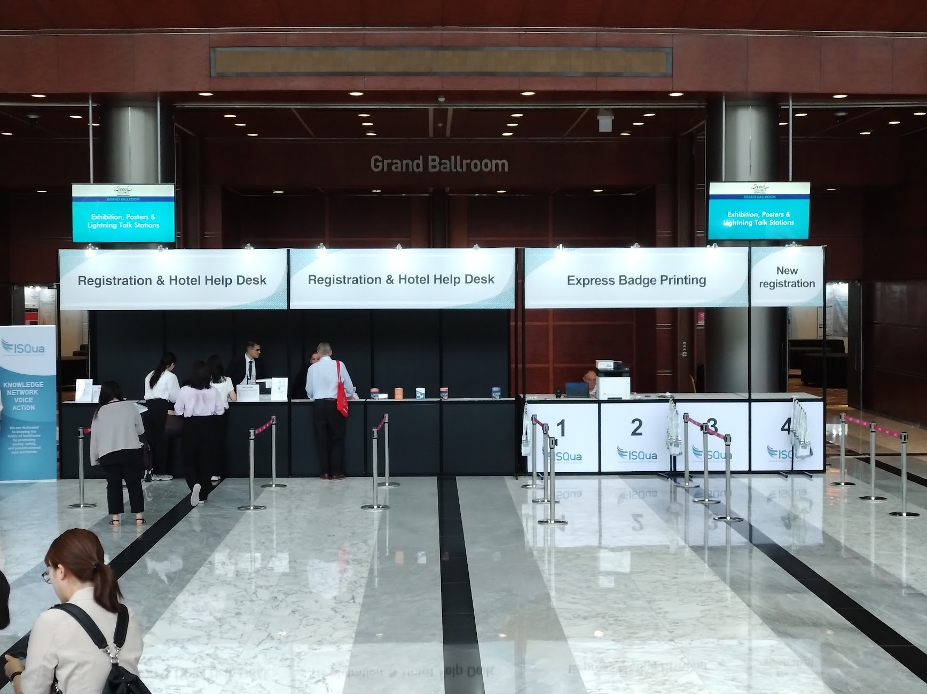

Slide 54
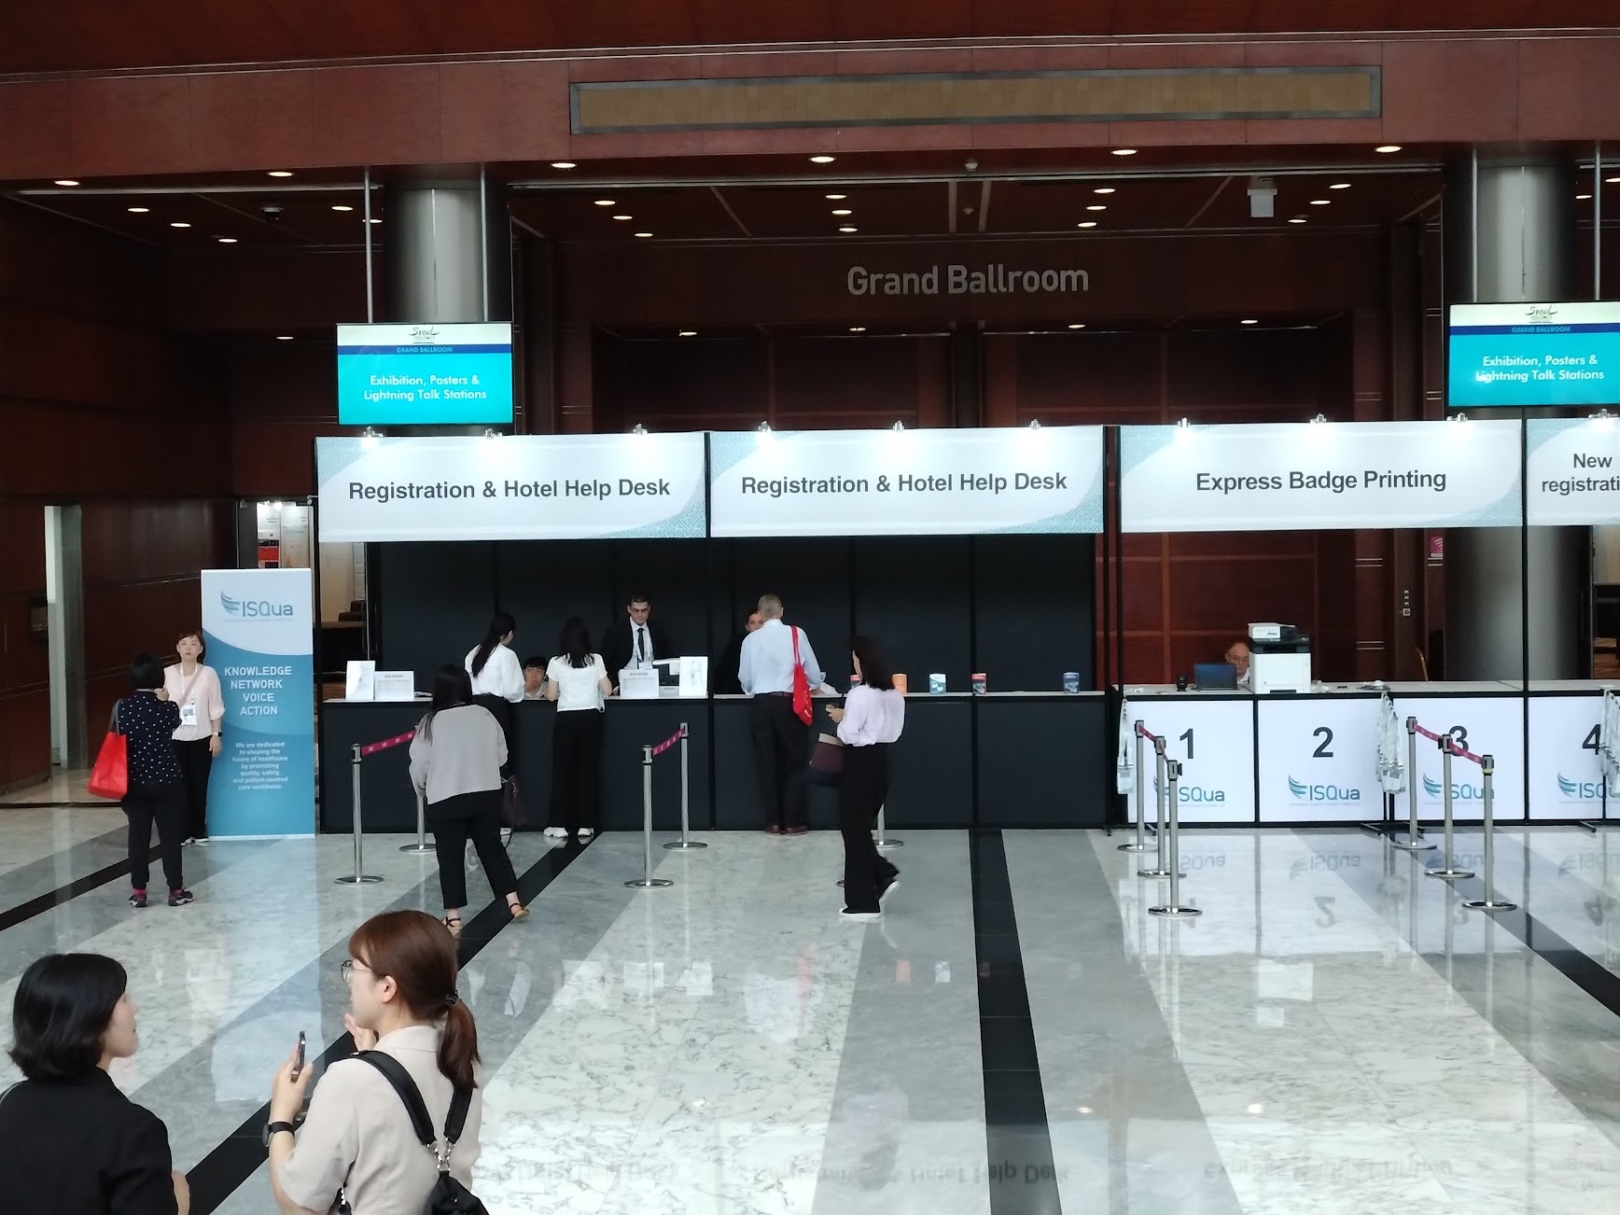

Slide 55
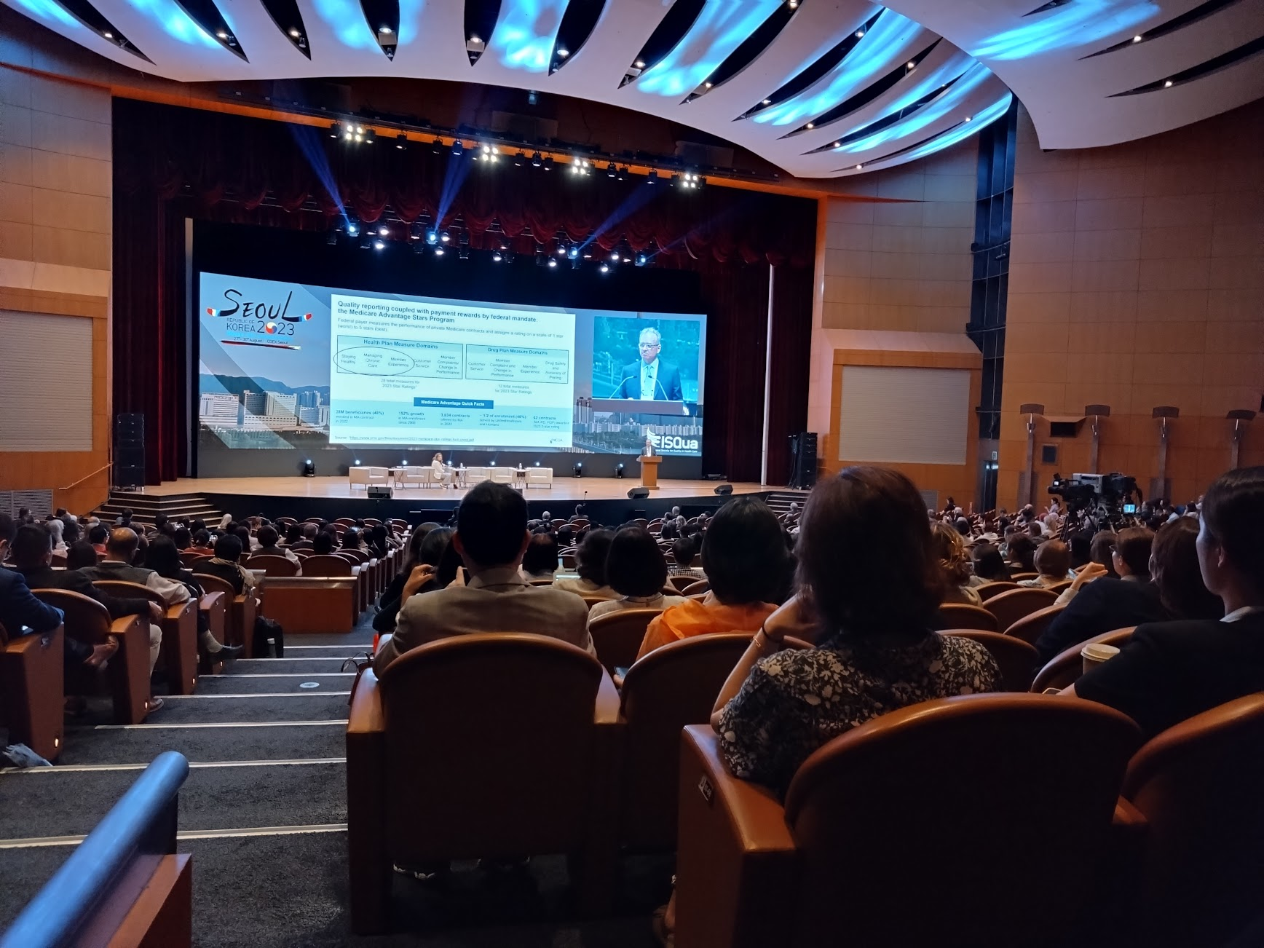

Slide 60
