Slide 1
Nail Disease Classification of Beau's lines, Terry's nails, and Clubbing through AlexNet with Attention
Presenter: Samantha Shih
－iFuzzy 2022－
Authors: Samantha Shih, Tzu-Yu Sun, Jun-Cheng Lin, Chiun-Li Chin
Notes:
Thank you all for being here today.
Let me briefly introduce myself. My name is Samantha Shih and we are students from Morrison Academy Taichung and Chung Shan Medical University.
My topic is “Nail Disease Classification of Beau’s lines, Terry’s nails, and Clubbing through AlexNet with Attention”

Slide 2
OUTLINE
01
Introduction
02
Related Works
03
Method
04
Results
05
Conclusion
Notes:
This presentation is split into five parts: the Introduction, Related Works, Method, Results, and the Conclusion.

Slide 3
01
Introduction
Notes:
First, the introduction. I will give a brief overview of the nail diseases chosen

Slide 4
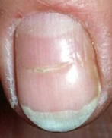
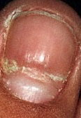
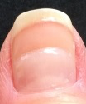
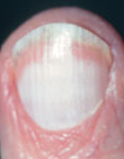
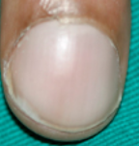
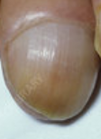
Introduction(1/2)
Though nail diseases themselves are not necessarily fatal, nail diseases can be indicators of severe health problems, making early diagnosis important.
Three common nail diseases were examined. All of the following nail diseases are associated with some severe health problems.
Beau’s lines, or depression of the nail plate.
Terry’s nails, or obliteration of the lunula.
Clubbing, or soft tissue swelling in the terminal phalanx resulting in straightening of the angle between the nail and nail bed.
1
Notes:
Though nail diseases themselves are not necessarily fatal, nail diseases can be indicators of severe health problems, making early diagnosis very important.
Three common nail diseases were examined. First is Beau’s lines, which is characterized by depression of the nail plate. Next is Terry’s nails, or the obliteration of the lunula. Third is clubbing, or soft tissue swelling in the terminal phalanx resulting in the straightening of the angle between the nail and the nail bed. All three of these diseases are more common and are all associated with some severe health problems.

Slide 5
Introduction(2/2)
In this research, we proposed AlexNet with Attention(AWA) to classify these three nail diseases.
Because nail diseases often act as an indicator of more severe diseases or health problems, early diagnosis of nail diseases can assist doctors in diagnosing other more severe diseases in their earlier stages.
2
Notes:
In this research, we use AlexNet with Attention, or AWA, to classify the three nail diseases chosen.
Because nail diseases often act as an indicator of more severe diseases or health problems, early diagnosis can assist doctors in determining these other diseases in their earlier stages.

Slide 6
02
Related Works
Notes:
Next, the second part of the presentation is on the related works.

Slide 7
Related Works(1/5)
In 2019, Juna and Dhananjayan found that because nails are located the farthest from the heart, nail diseases can act as a strong indicator of problems within the human body.
Classification of nail diseases would help indicate health problems.
In 2021, Gollins and Berker found that changes in color, size, shape, or textures of nails can be an indicator of systemic diseases.
They found that the ability to interpret nail diseases can help guide the diagnosis and management of a general medical patient.
For example, clubbing is often caused by a thoracic disease.
3
Notes:
In 2017, Nijhawan et al. classified multiple nail disease, one of which is Beau’s lines, through a hybrid of Convolutional Neural Networks. This only attained an accuracy of 84.58%, which we sought to improve.
Yani et al. classified Terry’s nails through Inception V3 and achieved an accuracy of 95.24%. However, this only classifies Terry’s nails, so it is not as applicable to the real world where there are many different nail diseases.

Slide 8
Related Works(2/5)
In 2017, Nijhawan et al. classified multiple nail diseases, one of which is Beau’s lines, through a hybrid Convolutional Neural Networks.
Though it could classify multiple nail diseases, it only attained an accuracy of 84.58%.
In 2019, Yani et al. classified Terry’s nails through Inception V3 and achieved an accuracy of 95.24%.
The accuracy is high but it only classifies Terry’s nails, which is not as applicable to the real world.
4
Notes:
In 2017, Nijhawan et al. classified multiple nail disease, one of which is Beau’s lines, through a hybrid of Convolutional Neural Networks. This only attained an accuracy of 84.58%, which we sought to improve.
Yani et al. classified Terry’s nails through Inception V3 and achieved an accuracy of 95.24%. However, this only classifies Terry’s nails, so it is not as applicable to the real world where there are many different nail diseases.

Slide 9
Related Works(3/5)
In 2021, Abdulhadi et al. classified multiple nail diseases including clubbing through five different pretrained Convolutional Neural Networks (AlexNet, VGG16, GoogleNet, ResNet50 and DenseNet201).
Though they were able to reach an accuracy of 96.39%, their dataset contained only 70 images per nail disease, making their model less generalized.
In 2021, Niu et al. reviewed attention mechanism in many models in recent years and found that it increases both the efficiency and the accuracy of perceptual information processing.
5
Notes:
In 2021, Abdulhadi et al. classified multiple nail diseases including clubbing.
From the above literature, we use a larger dataset to improve model generalization in this case, and we increase the types of diseases classified to better suit real world needs while attaining higher accuracy.
FB
SUMMARY: WHAT DID I FIND? ex. Found that most people use deep learning, don’t use attention, thus added attention to alexnet, OR add domain knowledge(ex. Nail disease important but few contributions)
Niu et al: https://www.sciencedirect.com/science/article/pii/S092523122100477X

Slide 10
Related Works(4/5)
In 2022, Wei et al. proposed AlexNet with attention mechanism to identify lesions in the nucleus.
The accuracy is higher than that of the model without the attention mechanism.
The benefit of using attention mechanism in AlexNet is great. We are the first to propose using the AWA model to classify the three nail diseases.
Summary:
6

Slide 11
Related Works(5/5)--Contributions
Most scholars use deep learning to classify nail diseases but do not use attention mechanism. Thus, we added attention mechanism for nail disease classification.
We are the first to propose AWA to focus on the less noticeable features that characterize three nail diseases.
Use of our method can improve the accuracy of nail disease classification of three specific nail diseases that no previous studies have classified.
Nail diseases can be indicators of severe health problems and have so many varieties that there are few contributions for many diseases, making our contribution significant.
7
Notes:
The following are our contributions.
We proposed AWA to focus on the less noticeable traits that characterize three nail diseases.
Use of our method can improve the accuracy of nail disease classification of three specific nail diseases that no previous studies have classified together.

Slide 12
03
Method
Notes:
Next, on method. I will introduce the training and testing processes.

Slide 13
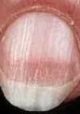
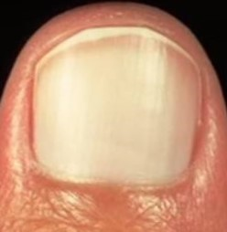
Method-Flowchart(1/8)
Training
AWA Model
Training
Images
Augmented
Images
Testing
AWA Model
Result
Testing
Images
Flow chart of overall process
8
Notes:
This flowchart is our proposed process.
It is divided into two parts: training and testing.
First, in the part for training, the first step is to input training images, which consist of images of the three types of diseases chosen. Then we augment the images. These images are then fed into the AWA Model to train it.
Next, in the part for testing, we feed the testing images into our AWA model for nail disease classification from training. The model outputs the resulting classification.

Slide 14
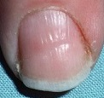
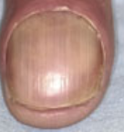
Method-Dataset(2/8)
All nail disease images are obtained from the Nails Image Dataset, an open dataset with 7 total classes of nail diseases.
There are 100 images for each class of disease to a total of 700 images in the dataset. Choosing three diseases is a total of 300 images.
Beau’s lines
Terry’s nails
Clubbing
9
Notes:
In this paper, all nail disease images are obtained from the Nails Image Dataset. These include 100 images of each type of disease: Beau’s lines, Terry’s nails, and Clubbing, to a total of 300 images. The images on the slide show what each type of disease looks like.

Slide 15
Method-Augment Image(3/8)
In order to enhance the generalization of the model, we rescale, rotate, and shift the images for performing data augmentation.
There are 55,200 images in the final dataset after augmentation.
Rotate Degrees | Original | Rescale | Rotation | Shift
Image
10
Notes:
In order to enhance the generalization of the model, we rescale, rotate, and shift the images through many different methods for augmentation.
There are 55,200 images in the final dataset after augmentation.

Slide 16
Method(4/8)
70%
The data is split with 70% for training, 10% for validation, and 20% for testing.
Validation
10%
Testing
20%
70%
Training
11
Notes:
The data is then split with 80% in training, 10% in validation, and 10% in testing. This means for each type of disease, 80 images are used for training, and validation and testing each use 10 images.
FB
Change 70-10-20
Why? Want to validate so take 10 percent from training
→ Because large dataset, so 80-20 → 70-10-20

Slide 17
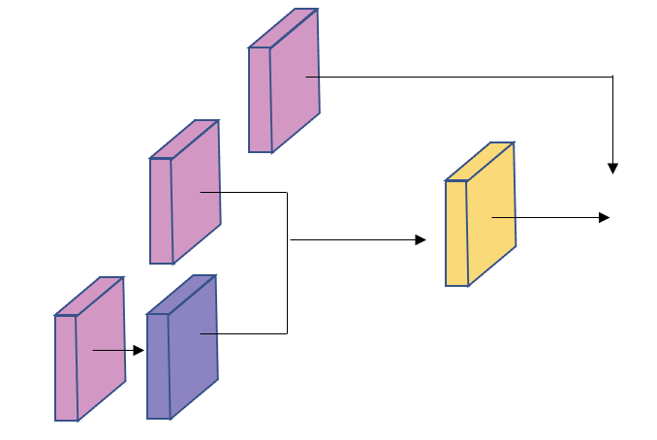
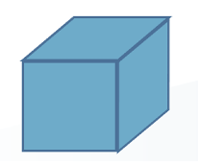
Method(5/8)
AWA was chosen because nails have less noticeable features that AWA can better focus on, thus improving accuracy.
Nail diseases are characterized by slight differences in areas such as the lunula.
Attention modules help the model focus on these areas.
Conv 2D
Upsampling
ReLU+Conv 2D+ReLU
Attention Module
12
Notes:
We chose to use AWA for nail disease classification because nails have less noticeable traits. AWA would be better able to focus on the slight differences of nails in areas such as the lunula. The attention modules help the model focus on these crucial areas. All of this helps boost the accuracy of classification.
FB
Add what attention module looks like

Slide 18
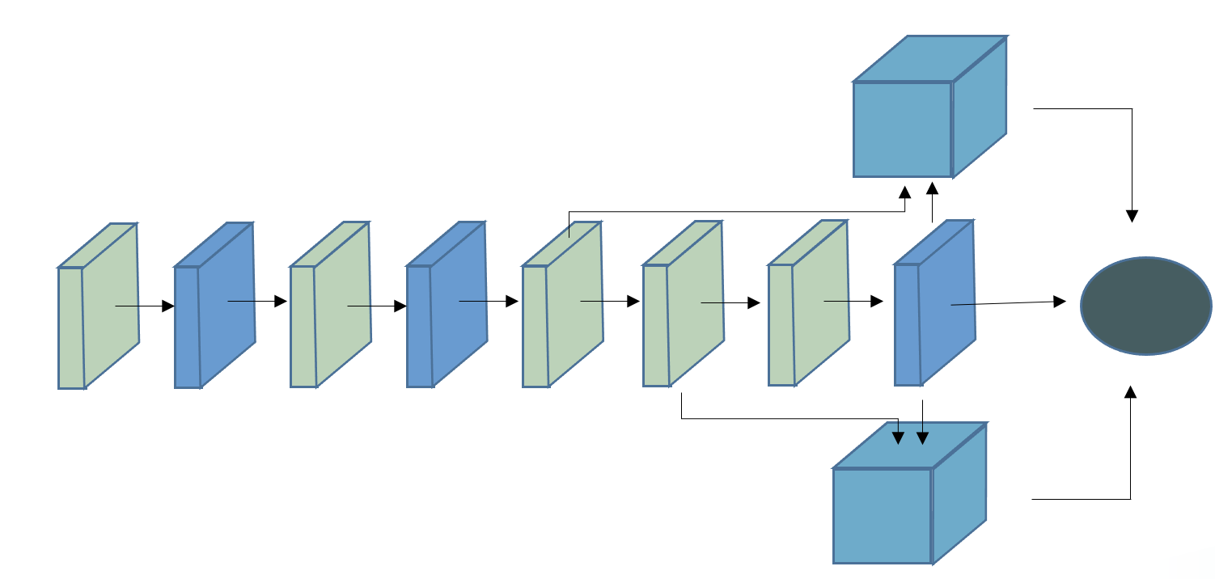
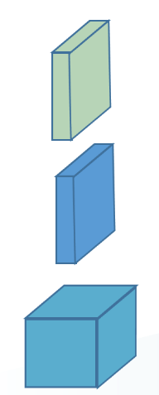
Method-AWA(6/8)
In AWA, the third convolution layer and third max pooling layer are input into one attention module, while the fourth convolution layer and third max pooling layer are input into the second attention module.
The results of each attention module and the third max pooling layer are then fused to determine the resulting classification of nail disease.
Conv 2D +ReLU
Max Pooling
Attention Module
Feature fusion
13
Notes:
In this paper, we propose AWA. In AWA, the third convolution layer and third max pooling layer are fed into one attention module, while the fourth convolution layer and third max pooling layer are fed into the second attention module. The results of each attention module and the third max pooling layer are then fused to determine the resulting classification of nail disease.

Slide 19
Method-Loss Function(7/8)
We use cross entropy as our loss function to evaluate the training performance of the model.
$$L_{total=} \frac{−1}{N} x\sum_{i=1}^{N}{y_{i} x log⁡(\hat{y_{i}})}+\left(1−y_{i}\right) x log(1−\hat{y_{i}})$$
y= the real nail disease category
$\hat{y}$= nail category predicted by the model
n= the number of classes
14
Notes:
This study uses the cross entropy loss function to evaluate the training performance of the model, where y represents the real nail category, $\hat{y}$ represents the nail category predicted by the model, and n represents the number of classes.

Slide 20
Method-Environment Setting(8/8)
CPU
Intel® Core ™
i9-11980HK CPU
Operating System
Windows
RAM
16GB
Code Language
Python
GPU
NVIDIA
RTX3090
Framework
Keras
15

Slide 21
04
Results
Notes:
Next, on the results of this paper.

Slide 22
Results(1/2)
After training AWA, we evaluated the performance by the confusion matrix.
 | Confusion Matrix Table
 | Ground Truth |  |  |  | Evaluation
Predicted |  | Beau’s lines | Terry’s nails | Clubbing | Accuracy 86.67% Sensitivity 86.67% Specificity 86.67% Precision 88.60%
 | Beau’s lines | 14720 | 0 | 0
 | Terry’s nails | 1840 | 14720 | 0
 | Clubbing | 1840 | 3680 | 18400
16
Notes:
After training AWA, we evaluated the performance by the confusion matrix. We found that accuracy, sensitivity, and specificity are all 86.67% respectively, while precision is 88.60%
Explain why accuracy, sensitivity, and specificity are low
These are actually high results for doctors though not high for computer scientists
Why some are wrong
Change numbers to after augmentation

Slide 23
Results(2/2)
The training accuracy was 97.50% and the testing accuracy was 86.67%.
Batch size was 22, epoch value was 230, learning rate was 0.001.
Beau’s lines and Terry’s nails are more likely to be inaccurately classified compared to clubbing.
This may be due to low resolution of misclassified images or the presence of more than one nail.
17
Notes:
Here are the results of our paper.
The training accuracy was 97.50% and the testing accuracy was 86.67%, which is when the batch size was 22, the epoch value was 230, and the learning rate was set to 0.001
We also found that Beau’s lines and Terry’s nails are more likely to be inaccurately classified compared to clubbing. This may be due to low resolution of misclassified images or the presence of more than one nail per image. Images could also be misleading because nails are so reflective that the images often contain light that could be mistaken for whitening of a part of the nail.

Slide 24
Discussion(1/2)
In the final result, the accuracy, sensitivity, and specificity of nail disease classification is 86.67%, respectively, while the precision is 88.60%.
In the confusion matrix, we found that the precision index of Beau’s lines is 100%, which increases the overall precision percentage.
Images were often classified inaccurately because of the existence of more than one nail per image or due to darker lighting and low resolution.
18

Slide 25
Discussion(2/2)
We found that Terry’s nails was misclassified as clubbing. A probable reason is that the white spots of the nail that characterize Terry’s nails were mistaken as the reflection that clubbing images often have.
The accuracy percentage of clubbing is 100%. It is the best identified of the three categories. A probable reason is that the straightening of the angle between the nail and nail bed that characterizes clubbing is very obvious and it has very distinct characteristics.
The use of AWA is also shown to have a higher classification accuracy than just AlexNet alone. When we tested AlexNet, it only achieved an accuracy of 83.0%. This shows that the accuracy is improved with AWA.
19

Slide 26
05
Conclusion
Notes:
Finally, our conclusion.

Slide 27
Conclusion
Using AWA can focus on the less noticeable features of nails that define three nail diseases, which achieves better results than just AlexNet.
An accuracy of 86.67% was reached, which is an improvement.
In the future, we hope to improve the accuracy and classify more categories of nail diseases which will assist doctors in diagnosis of nail diseases, leading to earlier diagnosis of any severe diseases associated.
20
Notes:
We conclude that using AWA can focus on the faint features of nails that define three nail diseases. An accuracy of 86.67% was reached, which is an improvement. Based on the present result, we hope to further improve the accuracy and possibly classify more categories of nail diseases in order to have a larger real-world application

Slide 28
Thank You
For Listening
Notes:
Thank you for listening!

